Slide 1


Summer 2019
Internship Project
Next Generation Test Set User Interface
&
Trident
By:
Vandana Anand
Software Engineering Intern
Notes:
Hi everyone! I’m Vandana Anand, a software engineering intern and I will be talking about the work I’ve been doing on the Trident and Unity Test Set UI project this summer.

Slide 2
Agenda
Introduction
Project Overview
Project Deliverables
What I Learned
Intern Experience

Slide 3




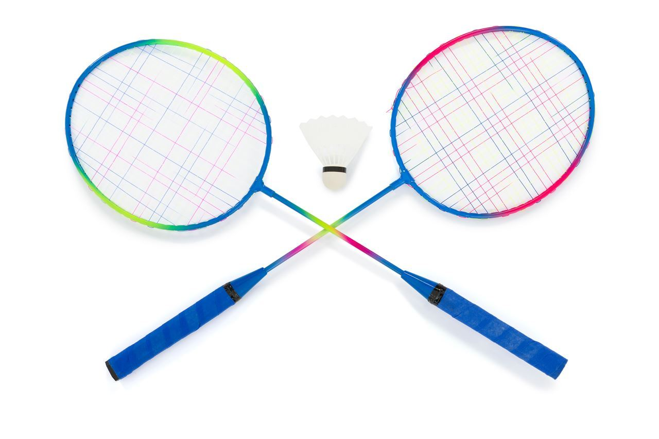
Vandana Anand
Hometown:
Boston MA
Love travelling:
11 countries & counting!
Rising Senior Computer Science
2020
Acapella
Badminton
Notes:
I am a rising senior at WPI. A few facts about me include that I’ve lived in the Boston area for most of my life, I love travelling and have been to 11 countries so far, and I am involved in the Acapella and Badminton club at school.

Slide 4
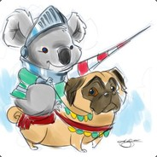
Storage
SPE DevOps
Test Automation Enablement
Koala Knights Intern Team
Manager: Anuradha Dravida
Scrum Master: Sangeeta Nippani
Mentor: Mingju Li
Peer Mentor: Ronak Lotia
Notes:
On to my organization, I am in the Storage Department in SPE DevOps on the Test Automation Enablement team
Worked in a team of four interns in an Agile/SAFE Environment. We got to pick a team name so we called ourselves the Koala Knights Intern Team
My manager is Anu, my scrum master, Sangeeta, who has helped keep us on track on our project work, and my mentors who have guided me during my internship, Mingju and Ronak.

Slide 5
The Project

Slide 6
Project Flow
Create a website that allows users to build testcases for testing programs
Generate a XML file containing testcase data inputted by the user or from the database
Pass this file through an existing Automatos Test framework to execute the testcases

Slide 7
Project Overview
Problem:
No Database for Trident data
No User Interface (UI) for both Trident and Unity data
Existing UI’s for Unity is very slow and the code is not maintainable or readable
Goals/Solution:
Design and develop a new Database for Trident data
Improve the prior UI concerns
Make the site more user-friendly
Organize code in a clear fashion and provide detailed documentation
Software Developing Life Cycle
Gather Requirements
Research
Design
Implementation
Deployment
Notes:
There were some problems that we had to overcome in that there was no database for Trident or user interface for both Trident and Unity so we had to design and implement one from scratch.
Testcase includes attributes such as parameter, test setting, and dependency. A Testcase is contained inside a Test Group which is contained inside a TestSet.
Unity is a storage product of the company that is currently on the market
Trident is the next generation and novel design of Unity and is not yet in the market
Gathered requirements, conducted research, implemented an initial design, implementation of the product using Agile and SAFE methodologies in which we had 2 week sprints to finish new version of our product, get feedback from the team, and keep updating our work as well as deployment of the website.

Slide 8
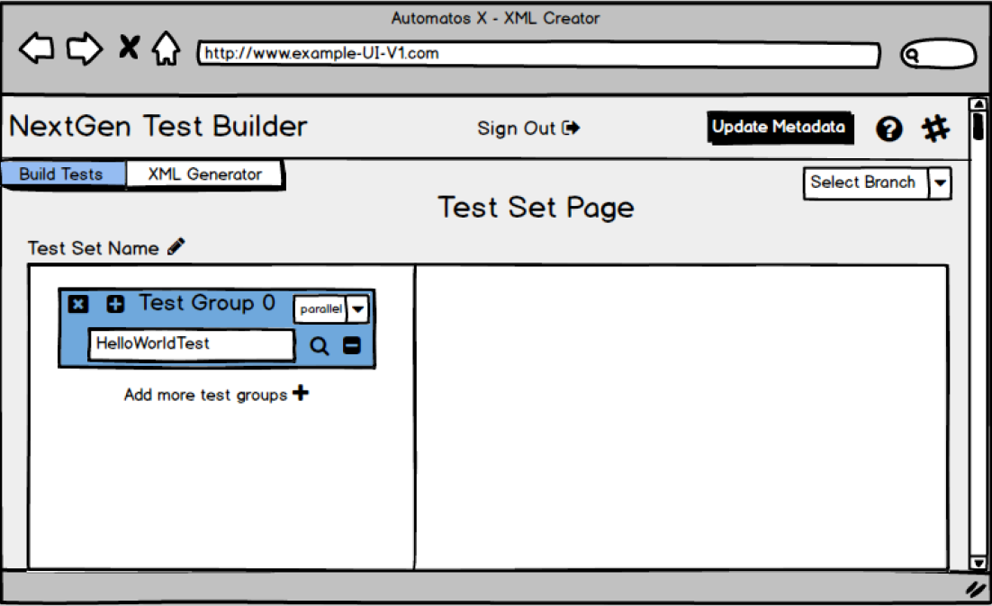
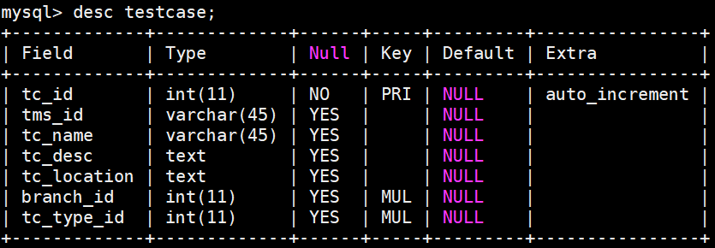
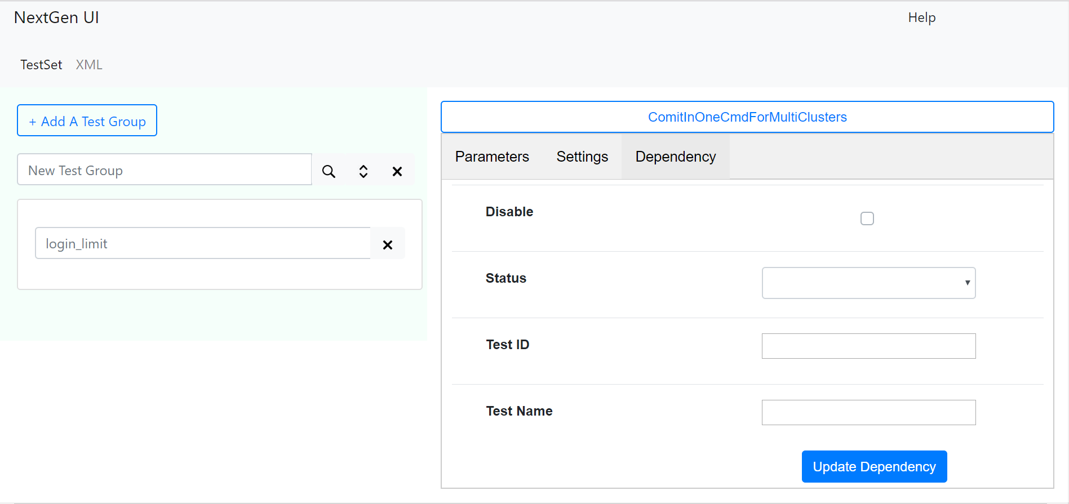
Contributions
UI Mockup
Database
UI Features
Design
Collecting feedback
Incorporating suggestions
Technologies Used: Balsamiq
Design
Getting approvals
Develop w/ Python script
Technologies Used: Python, mySQL, SQL Alchemy, LucidChart, CentOS 7 (Linux)
Navigation Bar
Test Setting & Dependency
Header & Help Menu
Technologies Used: AngularJS 7, JavaScript, HTML/CSS, Bootstrap, Flask
Notes:
CentOS 7 is an operating system that is distributed by Linux
Navigation bar to be able to navigate between parameter, test setting, and dependency
Challenges:
Learning about all the Storage concepts in the amount of time that we have
Learning about all the projects and terminology in the team
Learning about all the technologies that the team uses

Slide 9
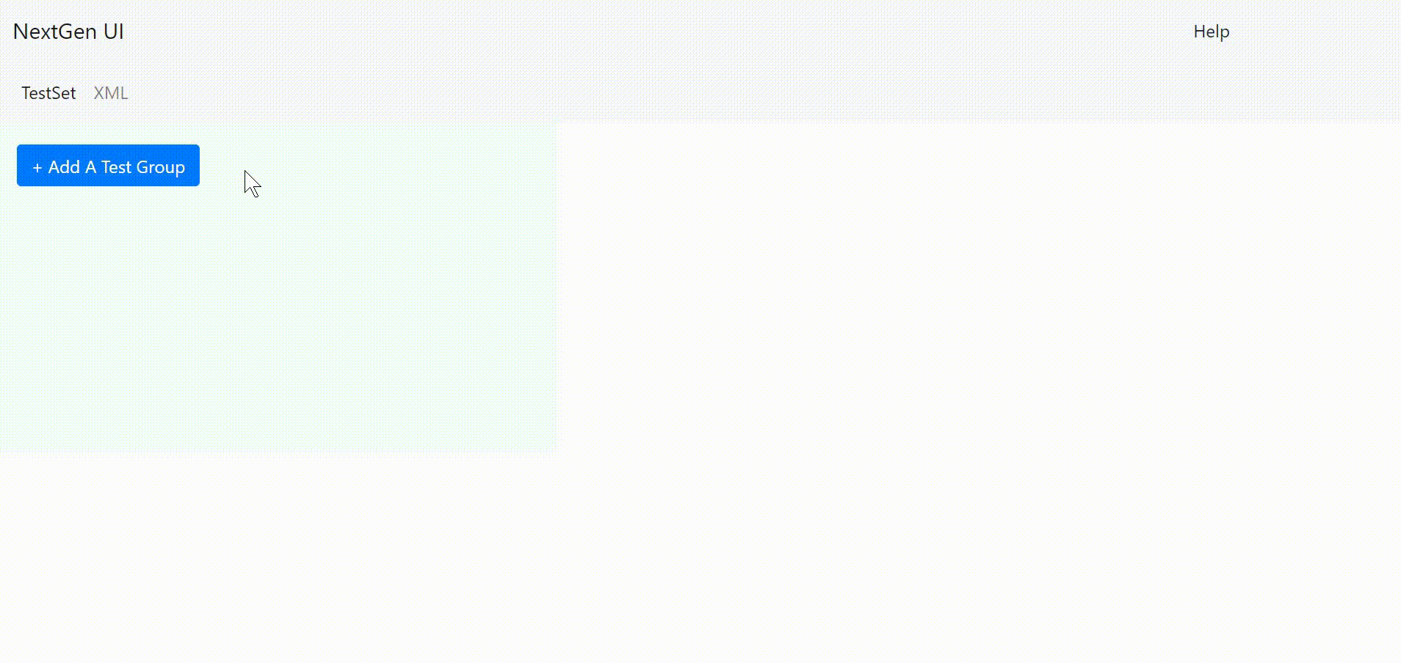
Project Deliverables
The new and improved UI
Notes:
Met our goals by making sure our website response time is fast to user’s requests and our code is clean, concise, readable, and maintainable.
Made the site more user friendly by adding a help button and demo video to show how to use the site.

Slide 10
My Experience

Slide 11
Technical Skills
Programming Languages
Database
UI/UX Design
Storage Unit Concepts
GitHub
Soft Skills
Presentation
Demo
Communication
What I Learned
Software Developing Life Cycle
Gather requirements
Research
Design
Implementation
Deployment
Networking
Met employees and interns outside of my department
Agile/SAFE/Jira
Experienced a different way of managing time and meeting deadlines
Notes:
Learned different programming languages that I didn’t have a lot of exposure to beforehand such as Angular and Javascript. Learned about building databases, UI/UX design by collecting feedback and developing new versions, storage unit concepts and terminology, GitHub concepts such as getting pull requests approved as well as collaborating with off shore teams such as the China team to learn UI concepts
Got to experience the SDLC from gathering requirements to deployment
Soft skills include presenting information, whether technical or non-technical, in a simplified/understandable way and demos to communicate in a technical manner

Slide 12
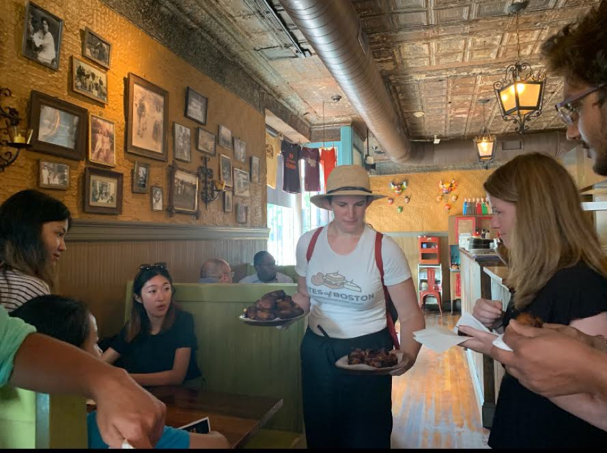
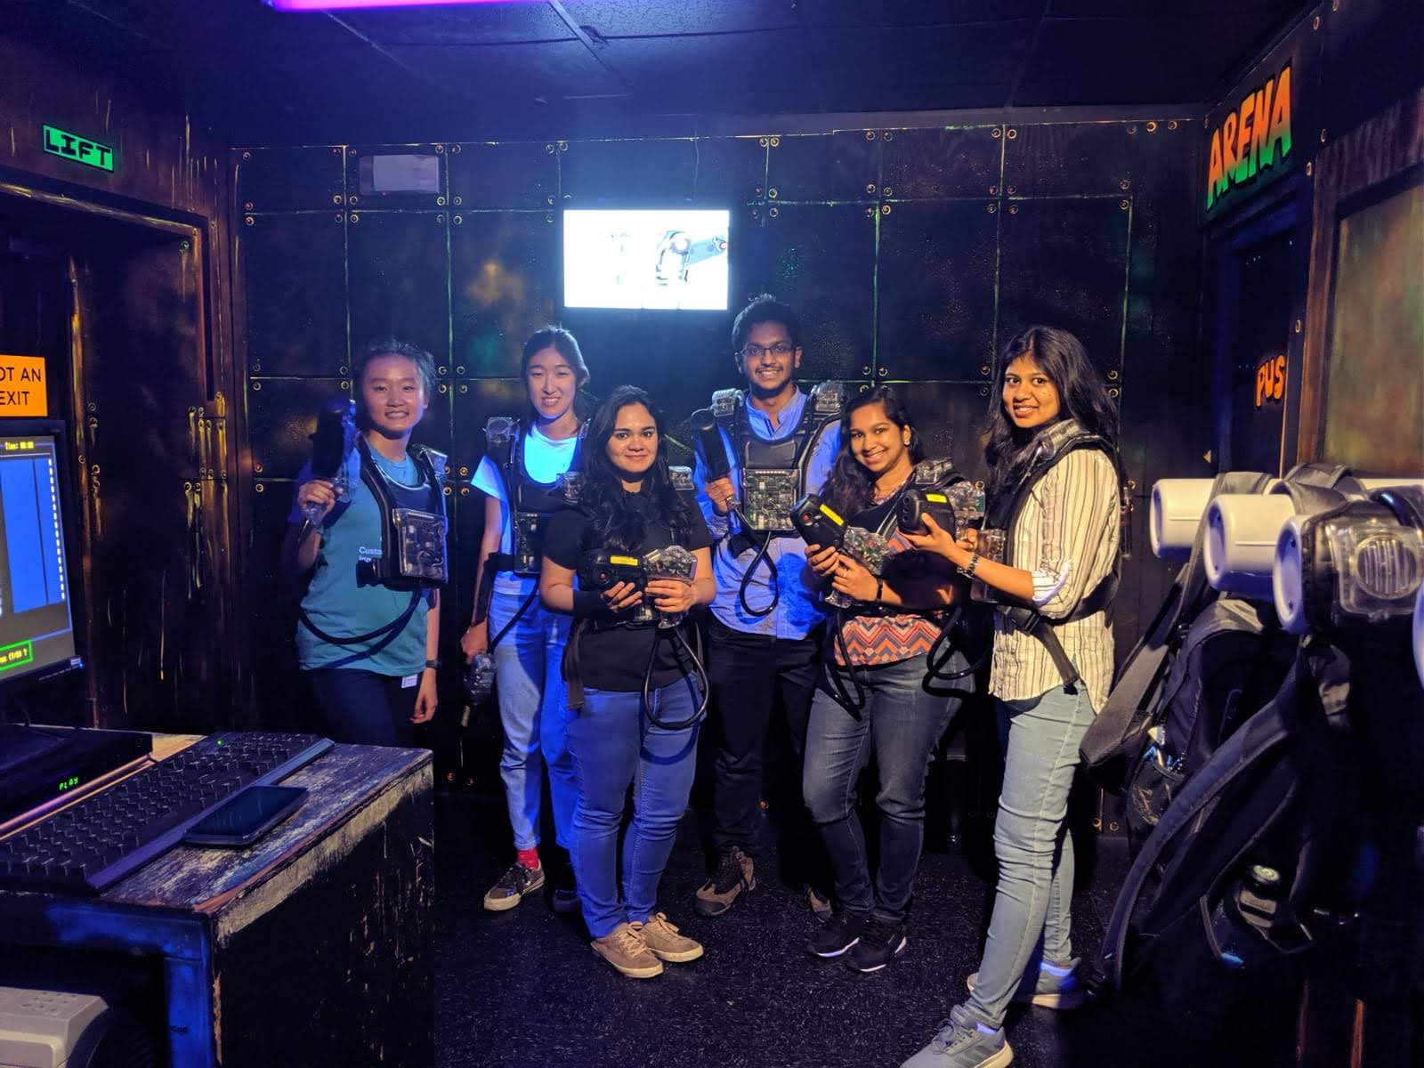
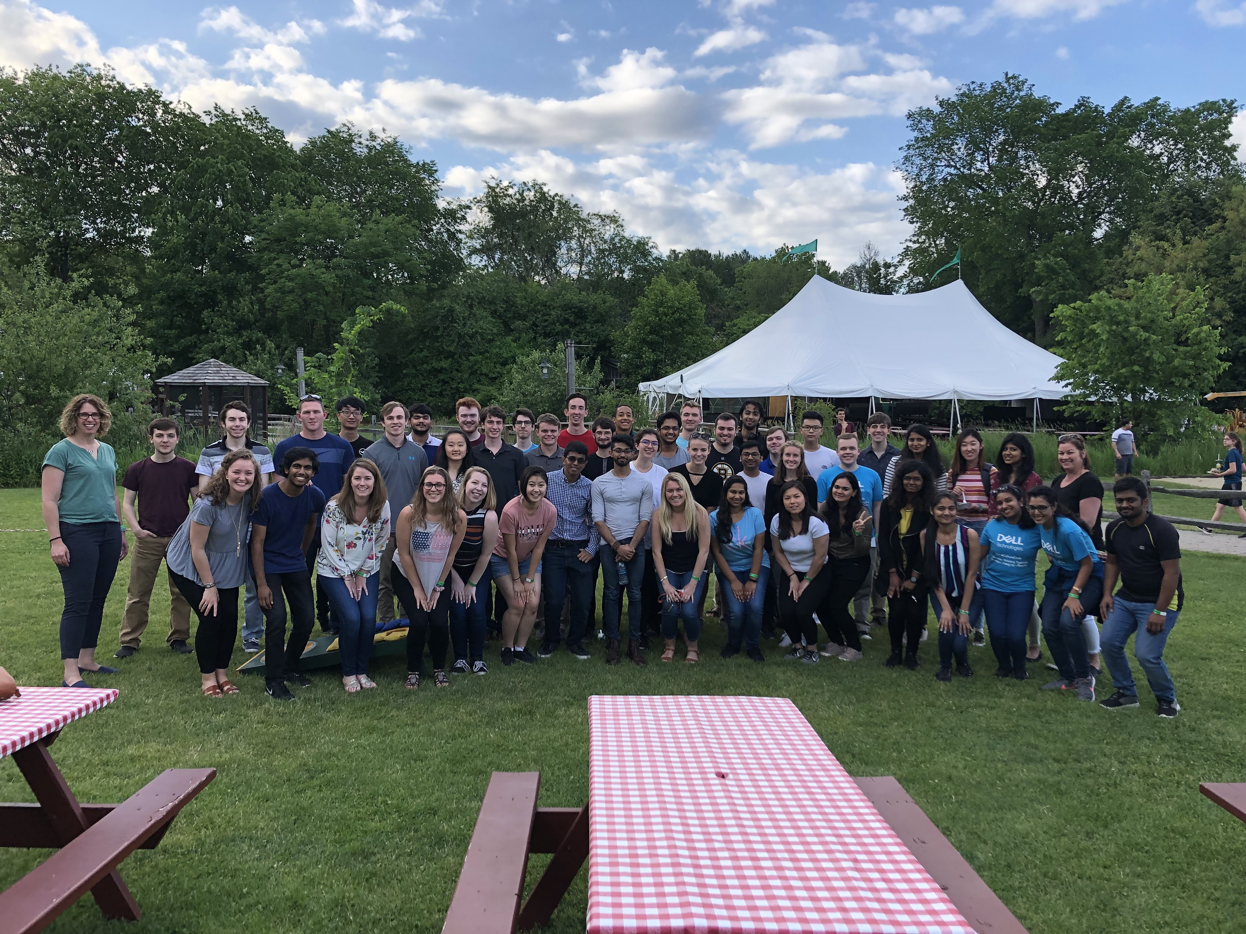

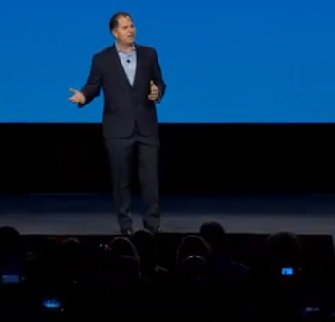
Intern Experience
Boston Food Tour
Apex Entertainment
Kimball Farms
Intern Training Classes
Speaker Series
Notes:
Overall interning at Dell EMC was a great summer experience. Not only did I get to grow professionally, but we also got to go to social events and meet interns outside of our departments, take intern training classes to develop our professional skills, and meeting senior management to learn more about their career paths

Slide 13
Thank you!
Questions?
Notes:
Thank you to all the people I have met and all of my team members who have provided me with great mentorship along my internship journey!

